Slide 1
情緒表達 Expression of emotions
幹部:許友瀞
幹部:陳翊熏

Slide 2
情緒表達是什麼? What is the “expression of emotions”
在舞台上能透過表情、眼神、聲音、動作來讓觀眾感受到當下表演者的情緒，使觀眾融入當下的氛圍。
Show your expression, wink, voice and action on the stage to make audiences blend into your mood.
讓我們來看看有那些常見的情緒吧!
Let's take a look at those common emotions

Slide 3
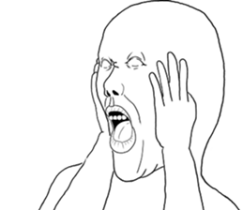
崩潰 CRUMBLE

Slide 4
開心 HAPPY

Slide 5
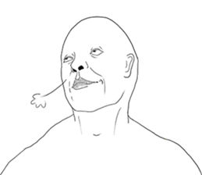
討厭 HATE

Slide 6
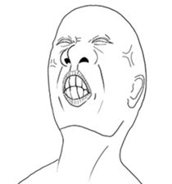
不耐煩 IMPATIENT

Slide 7
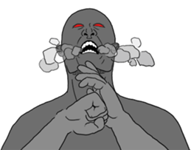
生氣 ANGRY

Slide 8
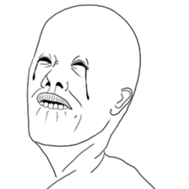
傷心 SAD

Slide 9
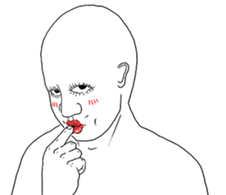
害羞 SHY

Slide 10
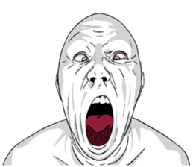
驚訝 SHOCKED

Slide 11
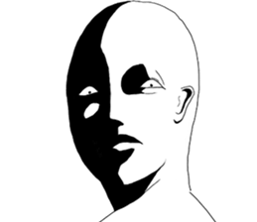
懷疑 SKEPTICAL

Slide 12
《遊戲時間》 Round one
將全部的人分為五組，每組會拿到一張紙條，上台後每個人會再抽到不一樣情緒來唸那個句子，希望大家可以使盡全力的表演喔!
Divide all the people into five groups. Each group will get a piece of paper. Then everyone will draw different emotions to read the sentence. Hope you guys can make the best performance！

Slide 13
《遊戲時間》 Round two
整組一起上台，桌上有五杯飲料，其中一杯與其他杯的口味不同，每人選一杯喝，並聽指令做出喝到XX的表情，最後由台下各組猜出誰喝到的不一樣。
The whole group took the stage together. There were five drinks on the table. One cup was different from the other cups. Each person chose a cup to drink and listened to instructions to make a facial expression. Finally, each group under the table guessed who was drinking different.

